Slide 1
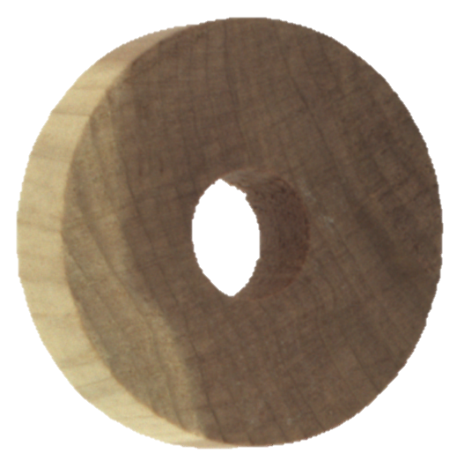
Industrial anomaly detection of wood texture using unsupervised learning for quality assessment process automation
By
Chaitanya

Slide 2
Agenda
1
Solution Overview
2
Data Source, Procurement and Other Details
3
EDA Details and Insights
4
Conclusion
5
Next Steps
6
Reference

Slide 3
Solution Overview
Accurate and swift quality inspection is very essential for meeting planned demand as well as maintaining good customer satisfaction scores in any manufacturing industry.
Project Scope: For current the project purpose we will be using images of manufactured wooden objects for training unsupervised models to identify possible defects in the object’s texture
Growing human resource cost is also one of the major factors which signals business to move out of traditional manual QA to automated one.
As occurrence of defects/anomalies is a rare instance hence less data to train models, this makes modeling anomalies very difficult
This problem of anomaly detection under the presence of low or no tagged data needs unsupervised machine learning and deep learning techniques instead of traditional classification based models
Majority of the industries deploys workers for manual identification of product defects
Though manual QA is works well for minor industrial units, heavy manufacturing industries which mass produces physical goods needs autonomous system for manufacturing as well as quality inspection
Manual inspection will not only slow down the manufacturing process but also has serious impact business operating cost
What
Why

Slide 4
Data Source, Procurement and Details
Data Source: Kaggle.com (Orginally shared by ITI-Instituto Tecnológico de Informática)
Source Description: Following is the source description as per Wiki “Kaggle, a subsidiary of Google LLC, is an online community of data scientists and machine learning practitioners. Kaggle allows users to find and publish data sets, explore and build models”
Method of Procurement: Direct download from Kaggle.com
Data Context: Data consists of set images belonging to an wooden objected manufactured post industrial operations. Images belong to a single product with looks like a wheel. Data provided has images for both good and faulty wooden objects under different folders. As the idea of the current project is to us unsupervised techniques for anomaly detection we will be using only images under “train” and “validation” folders (which only contains images of object without defects) and “test” (which only contains images of object with defects) for evaluation of unsupervised model developed.
Source Link: https://www.kaggle.com/datasets/itiresearch/wood-anomaly-detection-one-class-classification

Slide 5
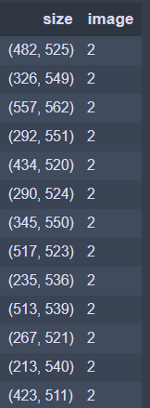
EDA Details and Insights
Total # of Non-Anomalous Images (Train):
Total # of Anomalous Images (Test):
Total # of Unique Image Sizes:
953
327
1,257 out of 1,280
Key Insights:
Table 1: Table showing a sample of images size and corresponding count of images
As its observed from the initial EDA that data extracted has only 953 image which is a bit less from ML/DL models to learn
To address this data quantity issue image rotation technique can be used for increasing data volumes for training
We have 1,257 unique image dimensions out of 1,280 images this shows that as part of pre-processing we need to resize the images before we start model development

Slide 6
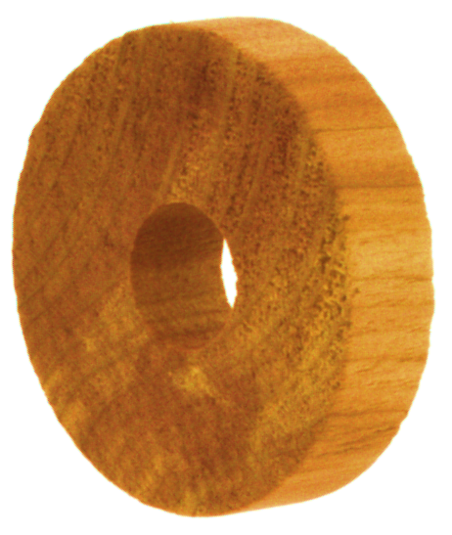
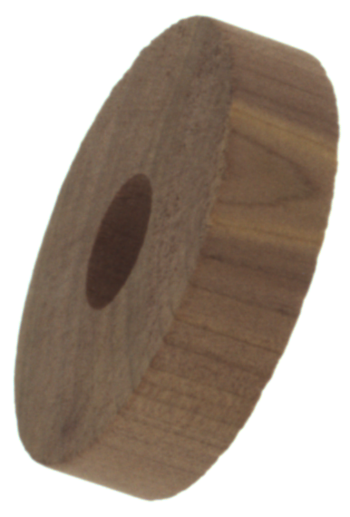
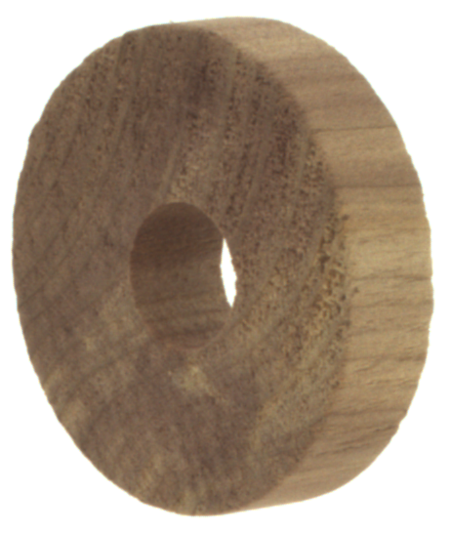
Sample Anomalous vs. Non-Anomalous Images
Non-Anomalous Image
Anomalous Image
Irregularities on the surface of wooden object
Key Observations:
Based on initial observation of the images, anomalies on the wooden object are majorly observed due to irregularities on the image while a proper object is expected to be smooth

Slide 7
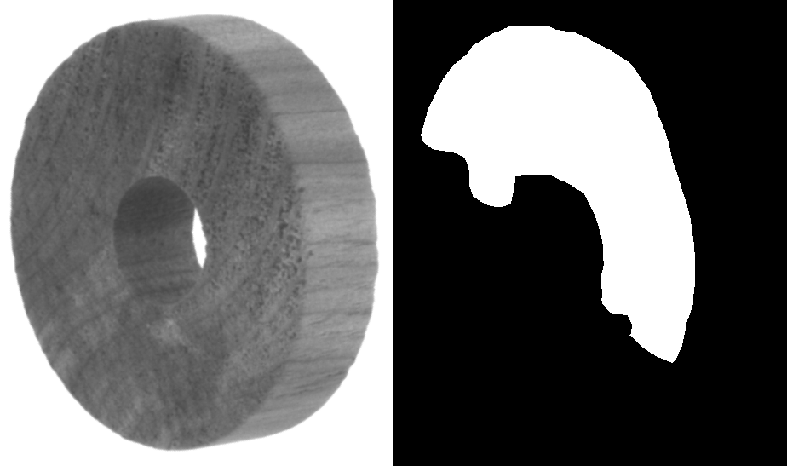
Understanding an Anomalous Object
Area with Irregularities
Anomalous Wooden Obj. (Coloured)
Non-Anomalous Wooden Obj. (B&W)
Non-Anomalous Wooden Obj. (Masked)
Key Observations:
Anomalies on the wooden object are majorly observed due to irregularities on the image
Rough surfaces on the wooden object has been to be identified by machine learning model developed. This can be challenging as irregularities are appearing similar to the colour patterns on the surface

Slide 8
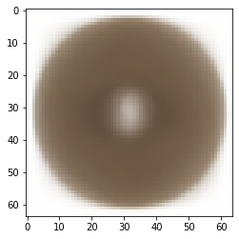
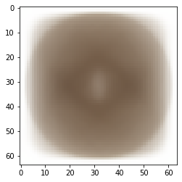
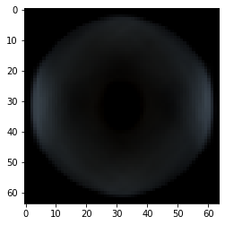
Do we observe any significant differences in an anomaly vs non-anomaly object?
Idea: A general idea differences between on all anomalous vs non-anomalous images can be identified by observed an “Average Image” or “Variance Image”. An average image is an image obtained by averaging pixel values of individual images similar a variance image is an image obtained by calculating standard deviation of pixel value of individual images.
Average Image of Anomalous Objects
Average of Non-Anomalous Objects
Difference Image
Key Observations:
Average image didn’t provide much information on anomaly vs non-anomaly due the data issue i.e., we have image with different dimension as well as rotations which in turn is causing issues for comparison

Slide 9




Addressing data quantity/size issue
Training data extracted from the source only has ~950 images for training which is relatively lower for training a good machine learning models. To address this problem we will be using image rotation technique where an image will be rotated around the median by a specified angle. In the current project we are apply three rotation to original image there by generating 3x additional data for modeling.
We have applied rotation by 90°, 180° and 270° for each original image which helped us in increasing the training data size from ~950 images to ~3800 images.
Image Rotated by 90°
Image Rotated by 270°
Original Image
Image Rotated by 180°

Slide 10
Eda Conclusion and Next Steps
Though in the initial EDA it was found that the data size is relatively smaller, image rotation can be used for generating additional datapoint to model
Anomalies observed on the wooden object are majorly due to irregularities (peak and valleys instead of smooth surfaces) and in majority of the cases it matches with the color patterns on the wood. This might make anomaly identification a bit complicated
We have 1,257 unique image dimensions out of 1,280 images this shows that as part of pre-processing we need to resize the images before we start model development
Next Steps
Data pre-processing based on EDA observations
Model Development

Slide 11
References
[1] Agnieszka Mikołajczyk; Michał Grochowski Data augmentation for improving deep learning in image classification problem 2018 International Interdisciplinary PhD Workshop (IIPhDW)
[2] Yaren Celik, Selda Guney & Berna Dengiz Applications of Deep Learning Techniques to Wood Anomaly Detection Part of the Lecture Notes on Data Engineering and Communications Technologies book series (LNDECT,volume 144)
[3] https://cs.nju.edu.cn/zhouzh/zhouzh.files/publication/icdm08b.pdf?q=isolation-forest
[4] https://www.kaggle.com/datasets/itiresearch/wood-anomaly-detection-one-class-classification

Slide 12
Thank You

